Slide 1
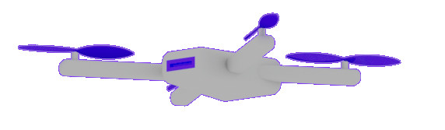
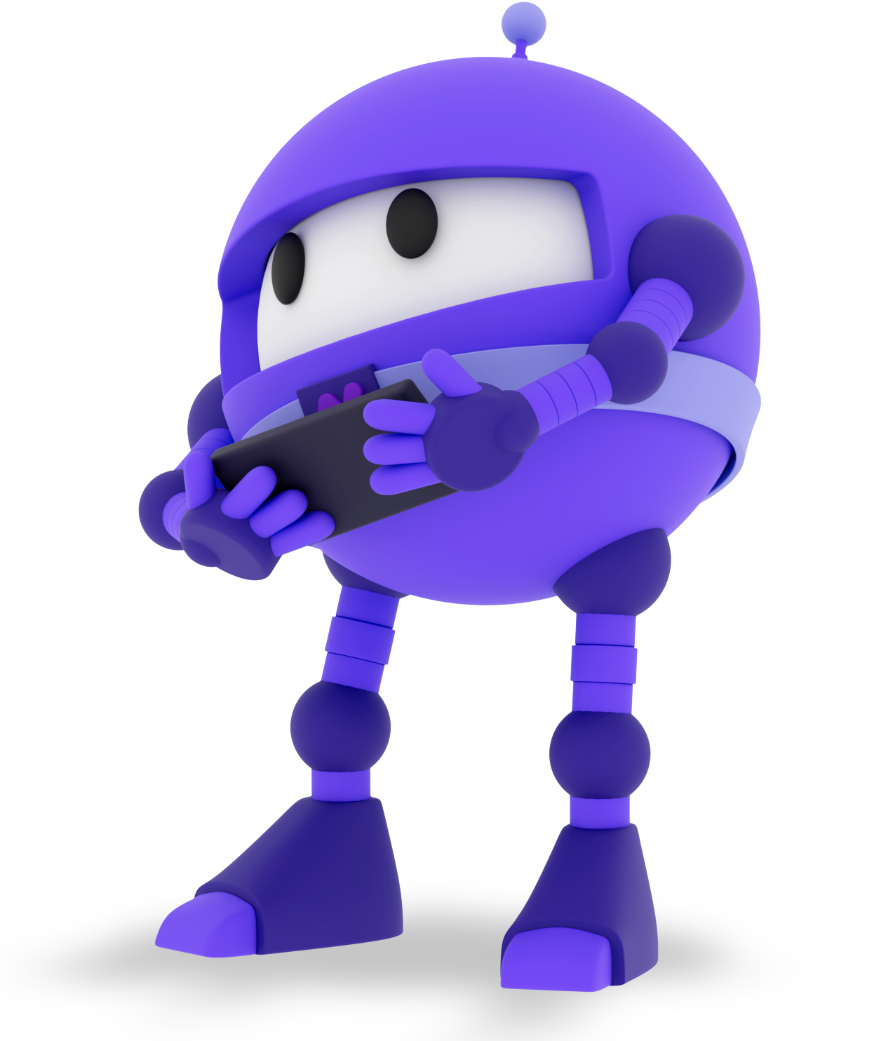
Welcome to
.NET Conf 2022!
David Ortinau | @davidortinau
Maddy Montaquila | @maddymontaquila

Slide 2
.NET MAUI
Six Month Check-in

Slide 3
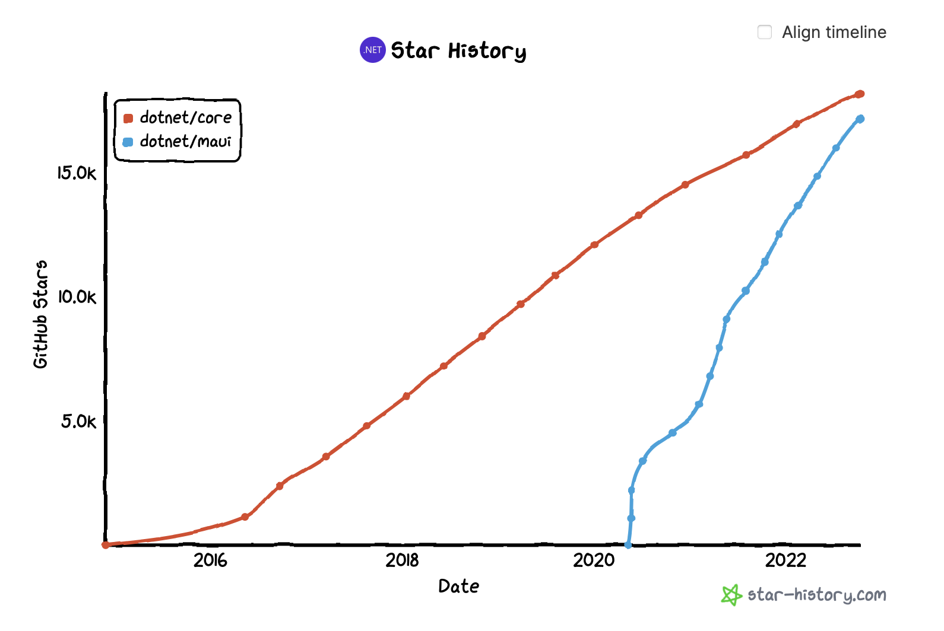
.NET MAUI Growth YTD
+160%

Slide 4
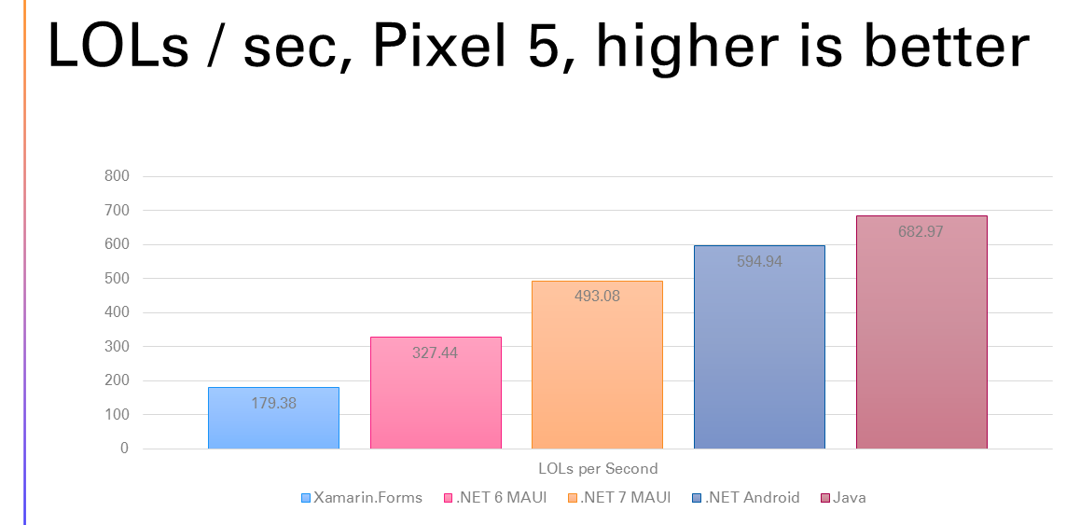
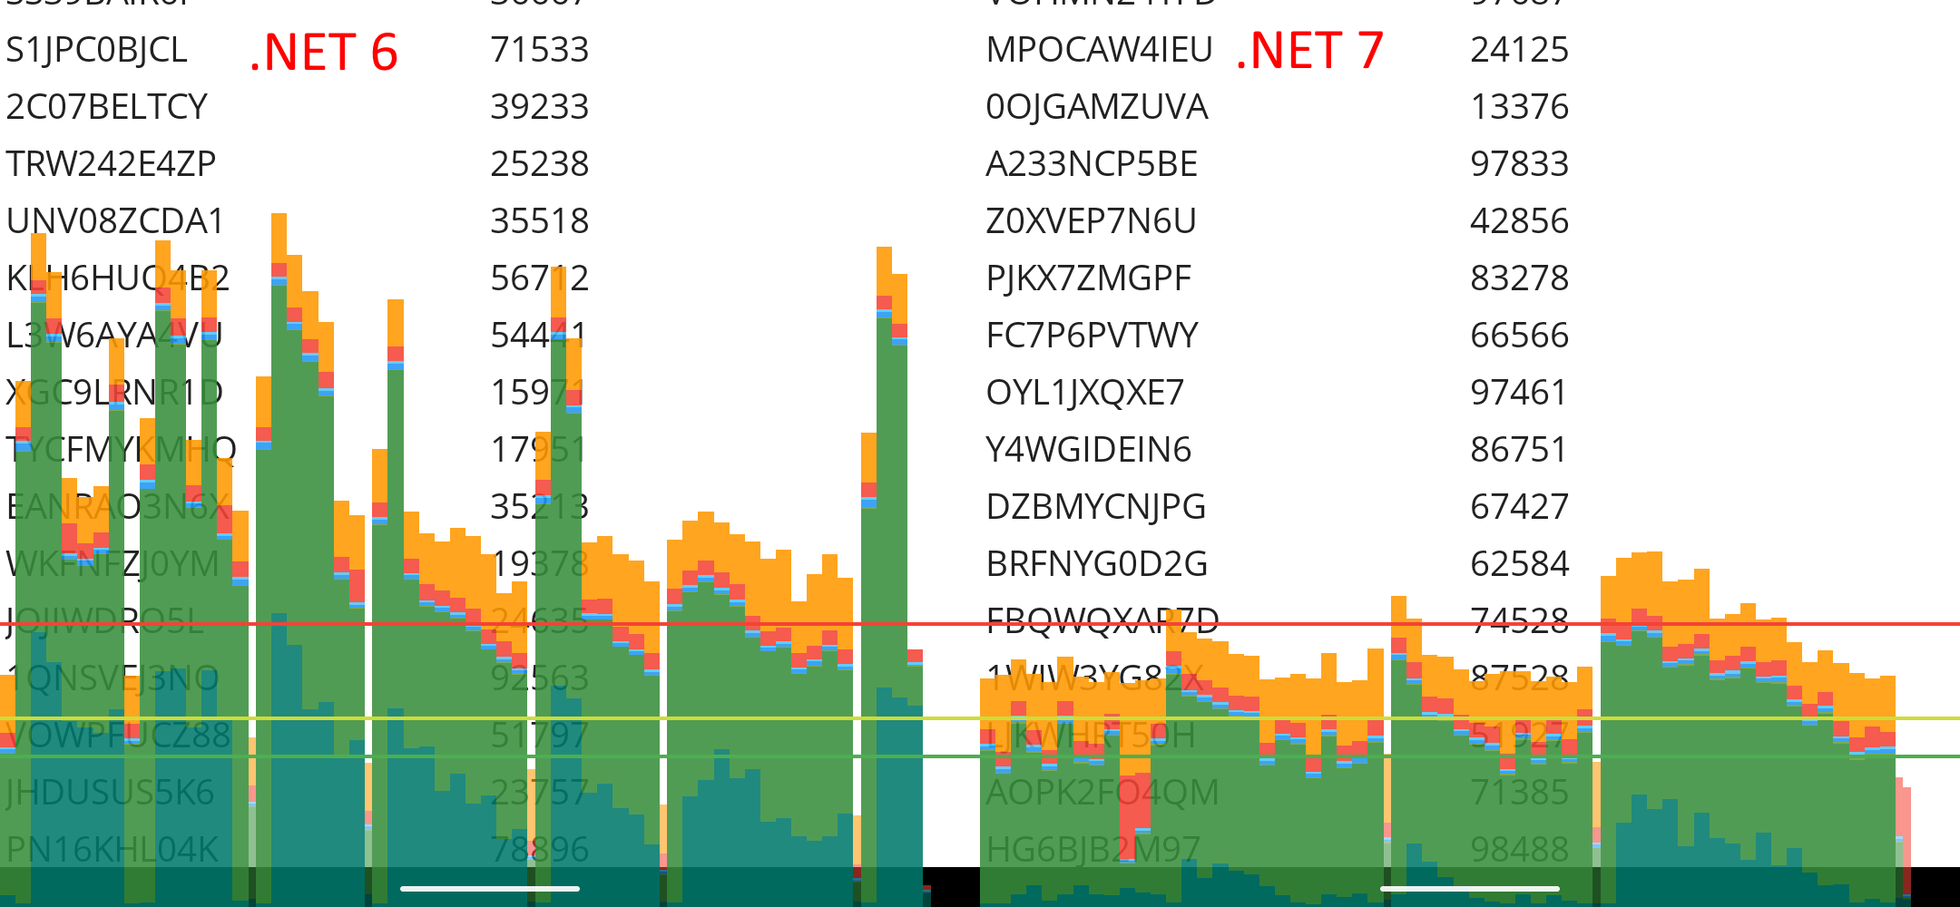
.NET MAUI 7 Performance
51% faster rendering
Faster scrolling
https://aka.ms/maui-7-perf
Notes:
Pixel 5 went from ~327 per second to ~493 per second moving from .NET 6 to .NET 7:

Slide 5


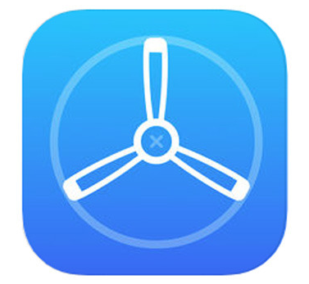
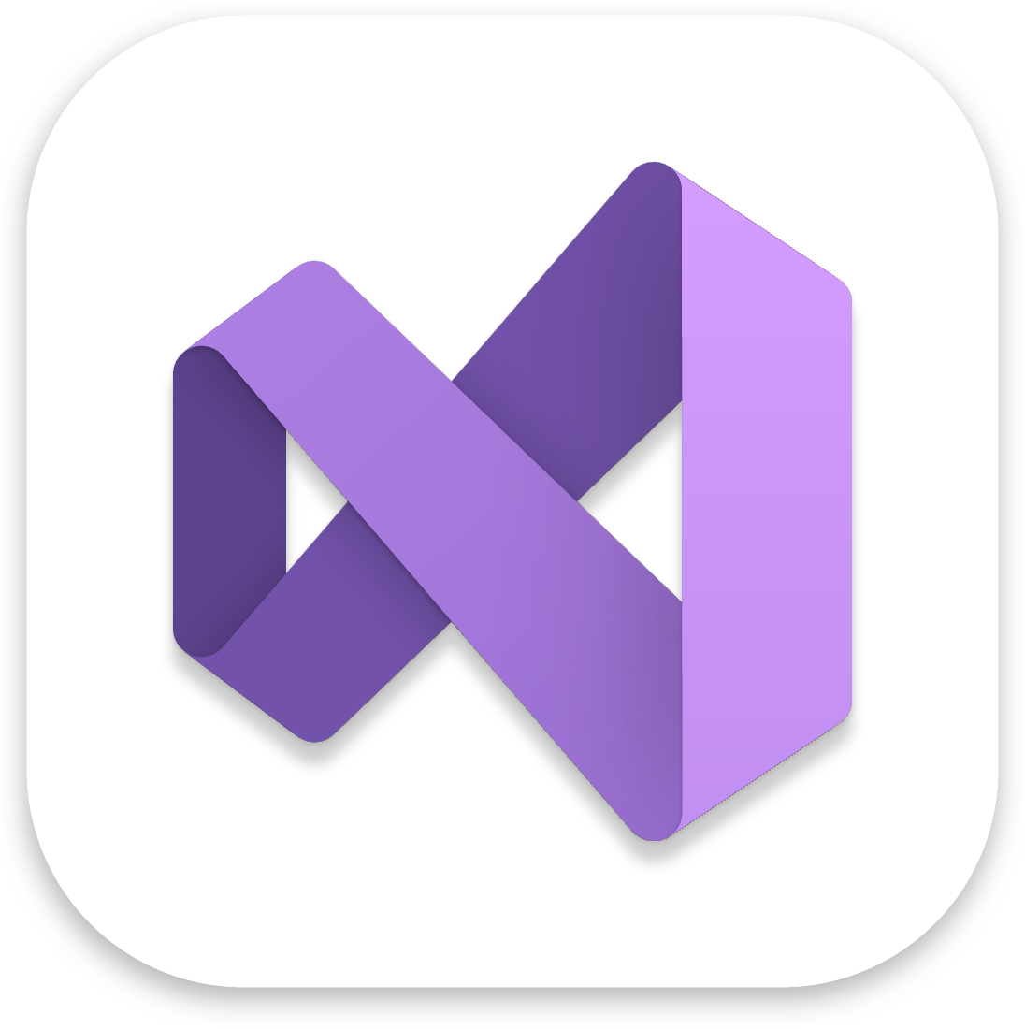










Complete Product Lifecycle
Develop
Test
Build
Distribute
Monitor
*Coming Soon!

Slide 6




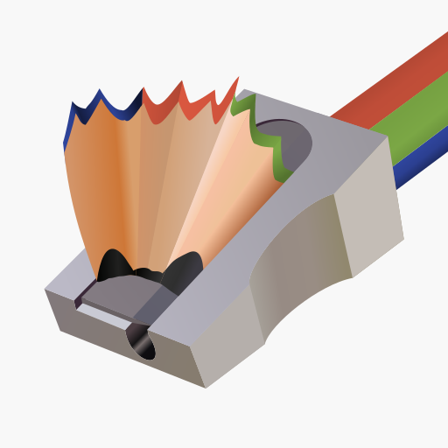



















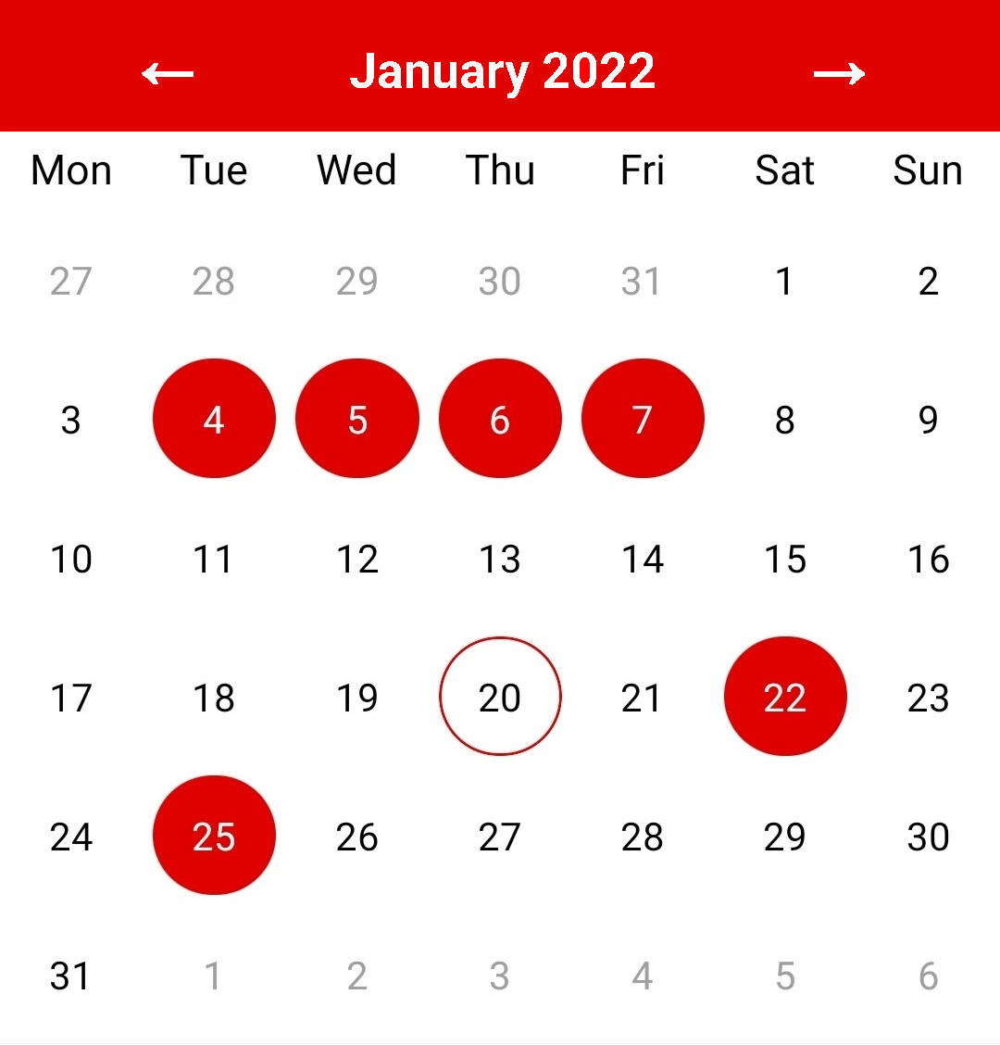




























Slide 8
.NET MAUI
Your Successes

Slide 9

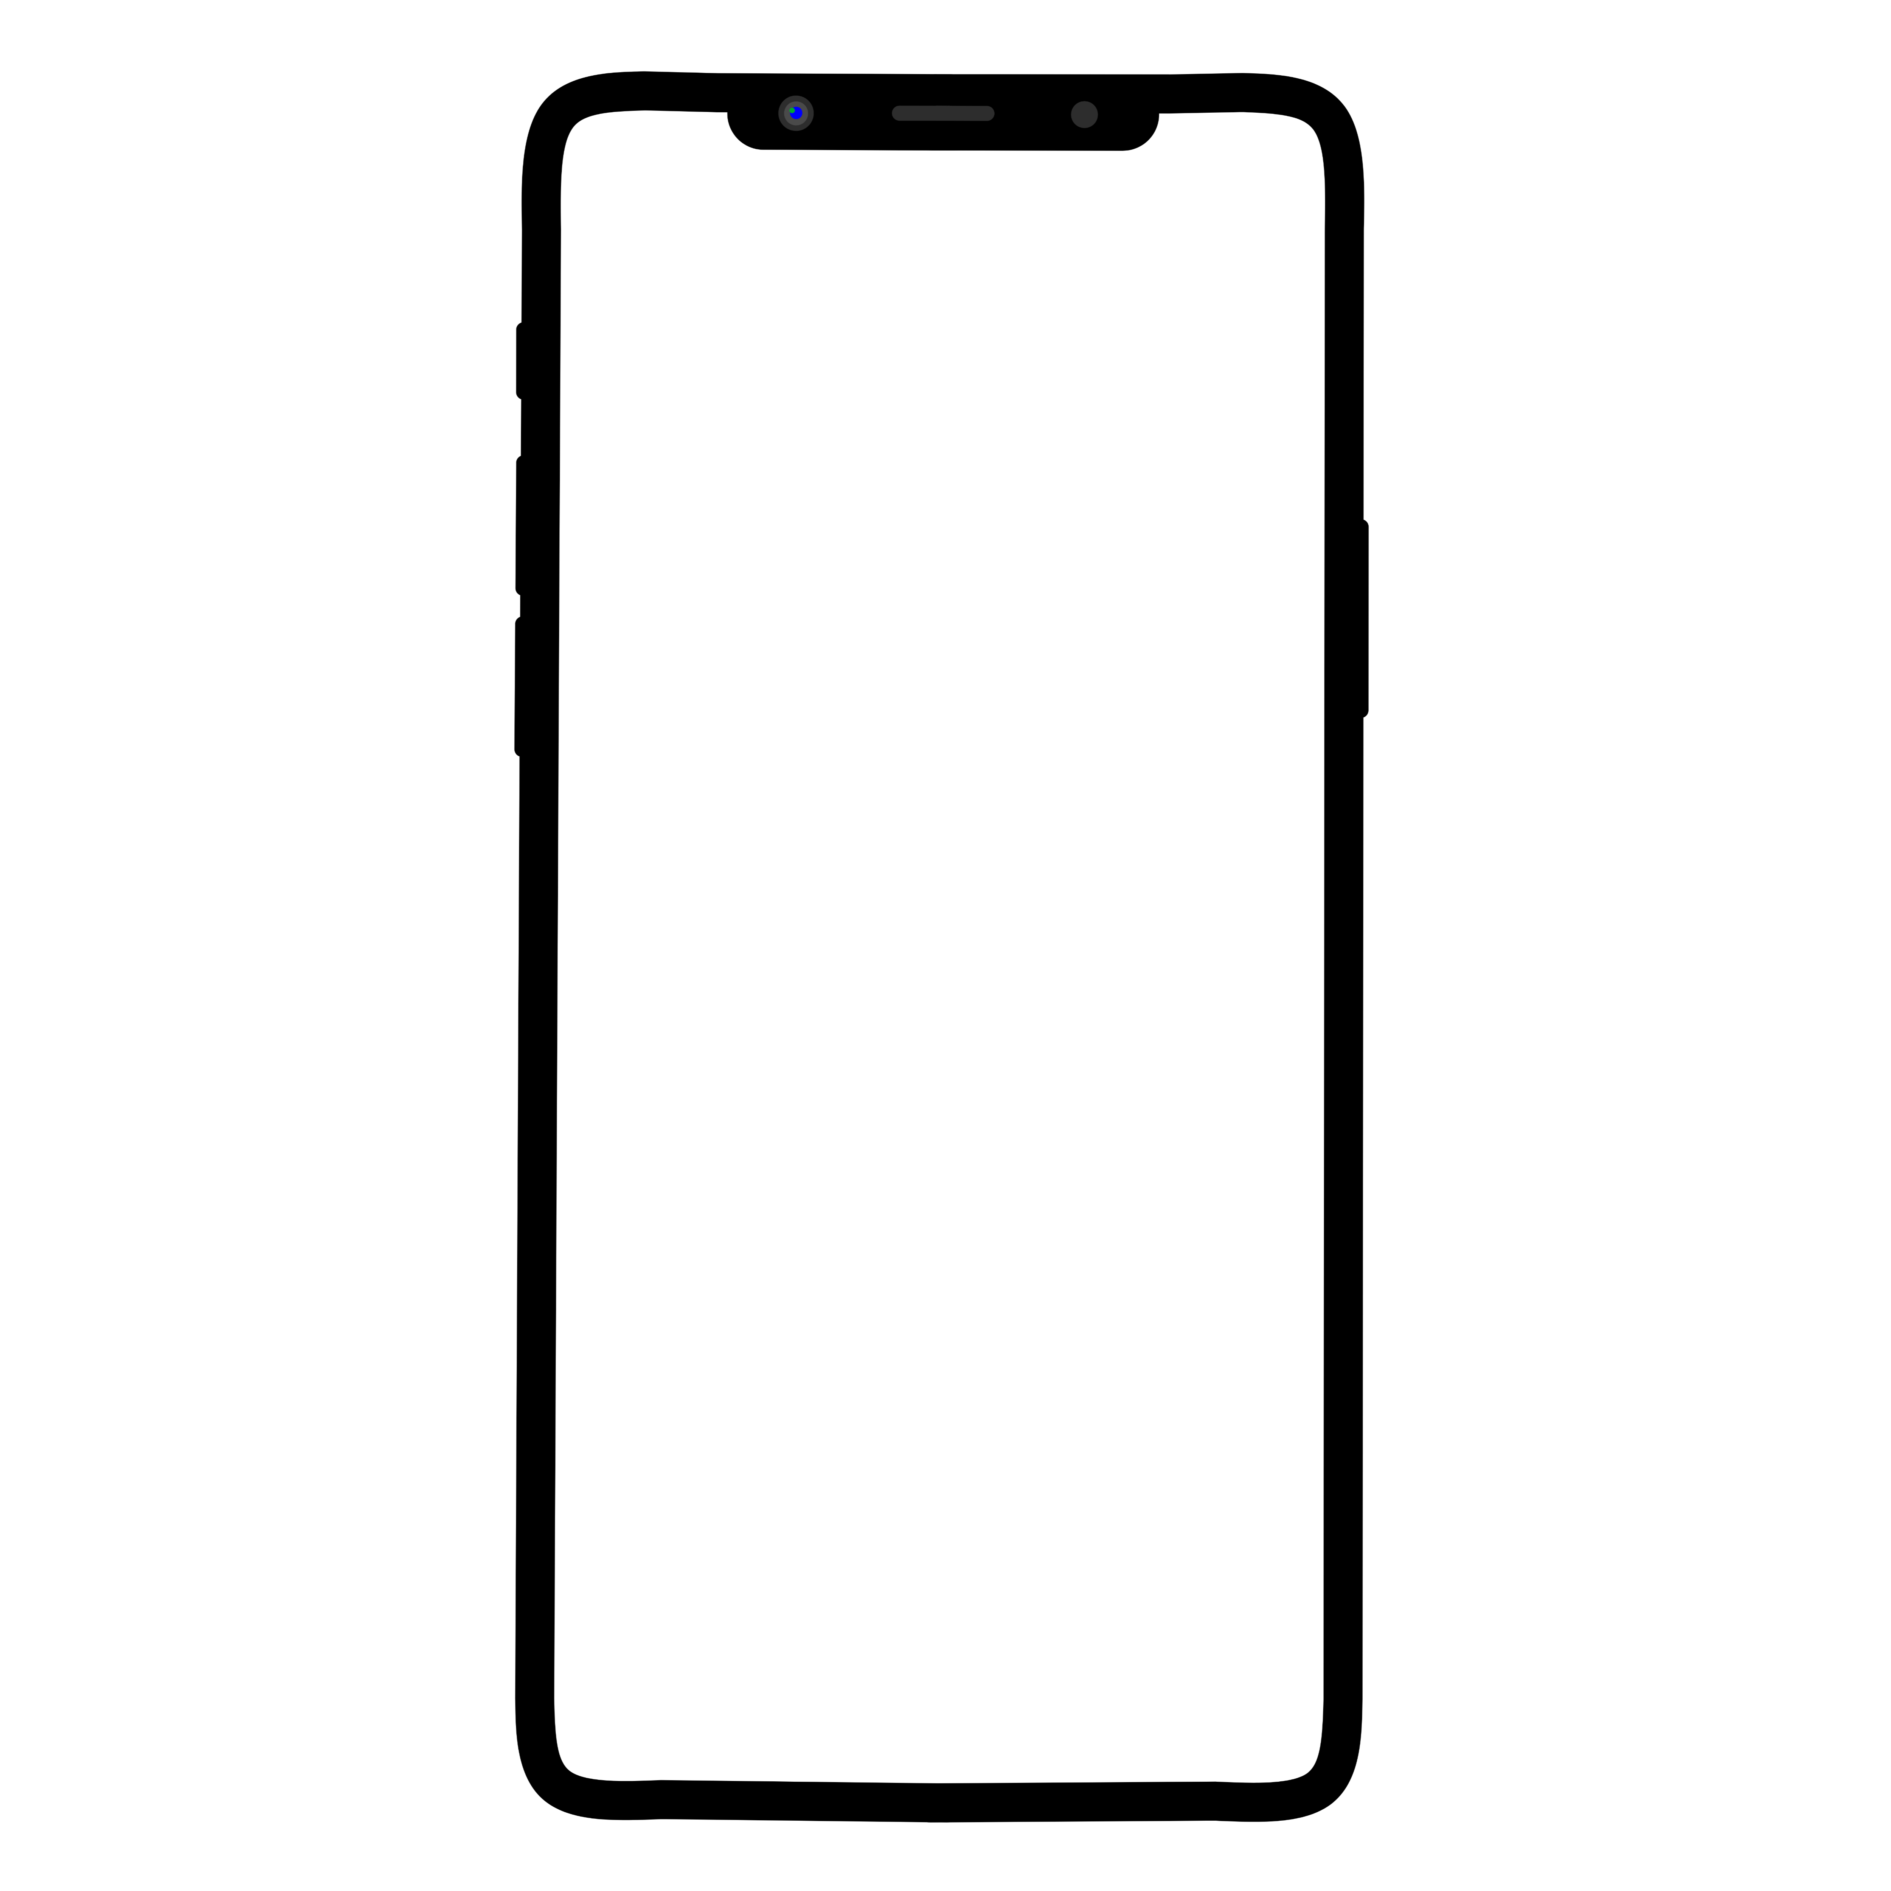
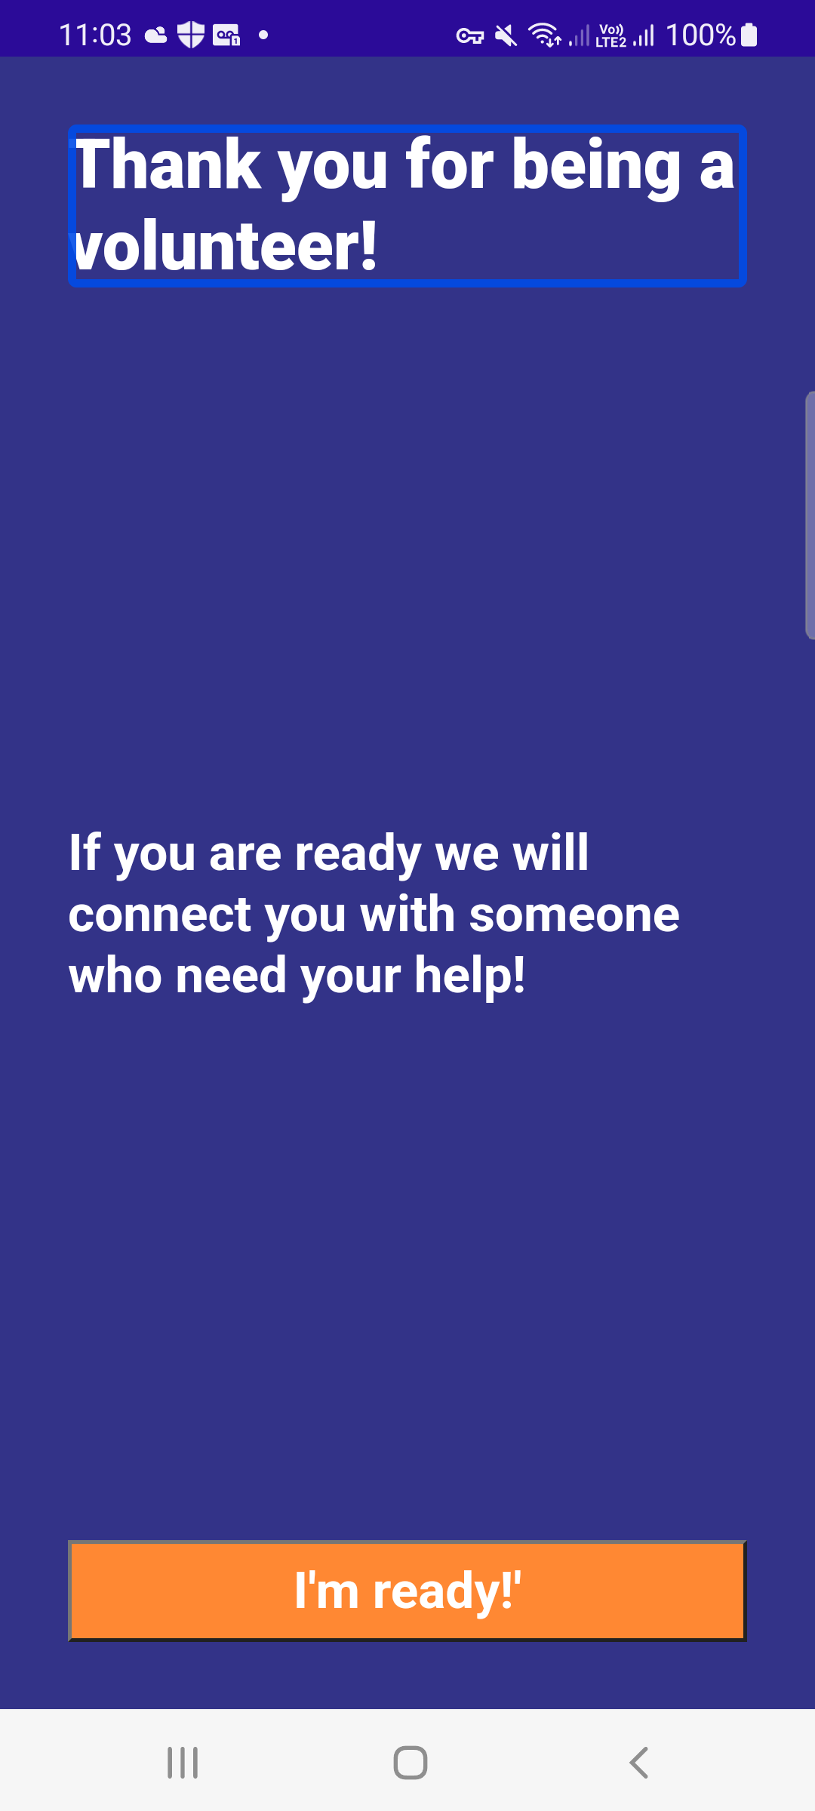
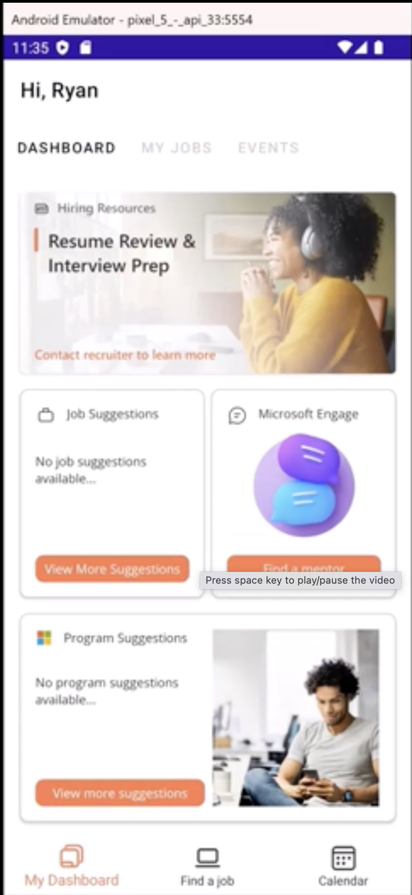
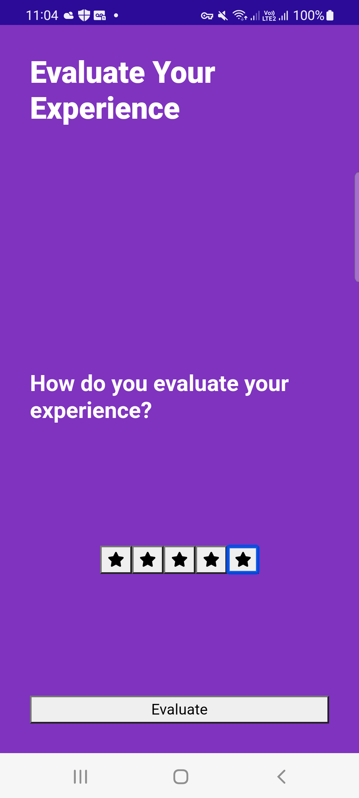
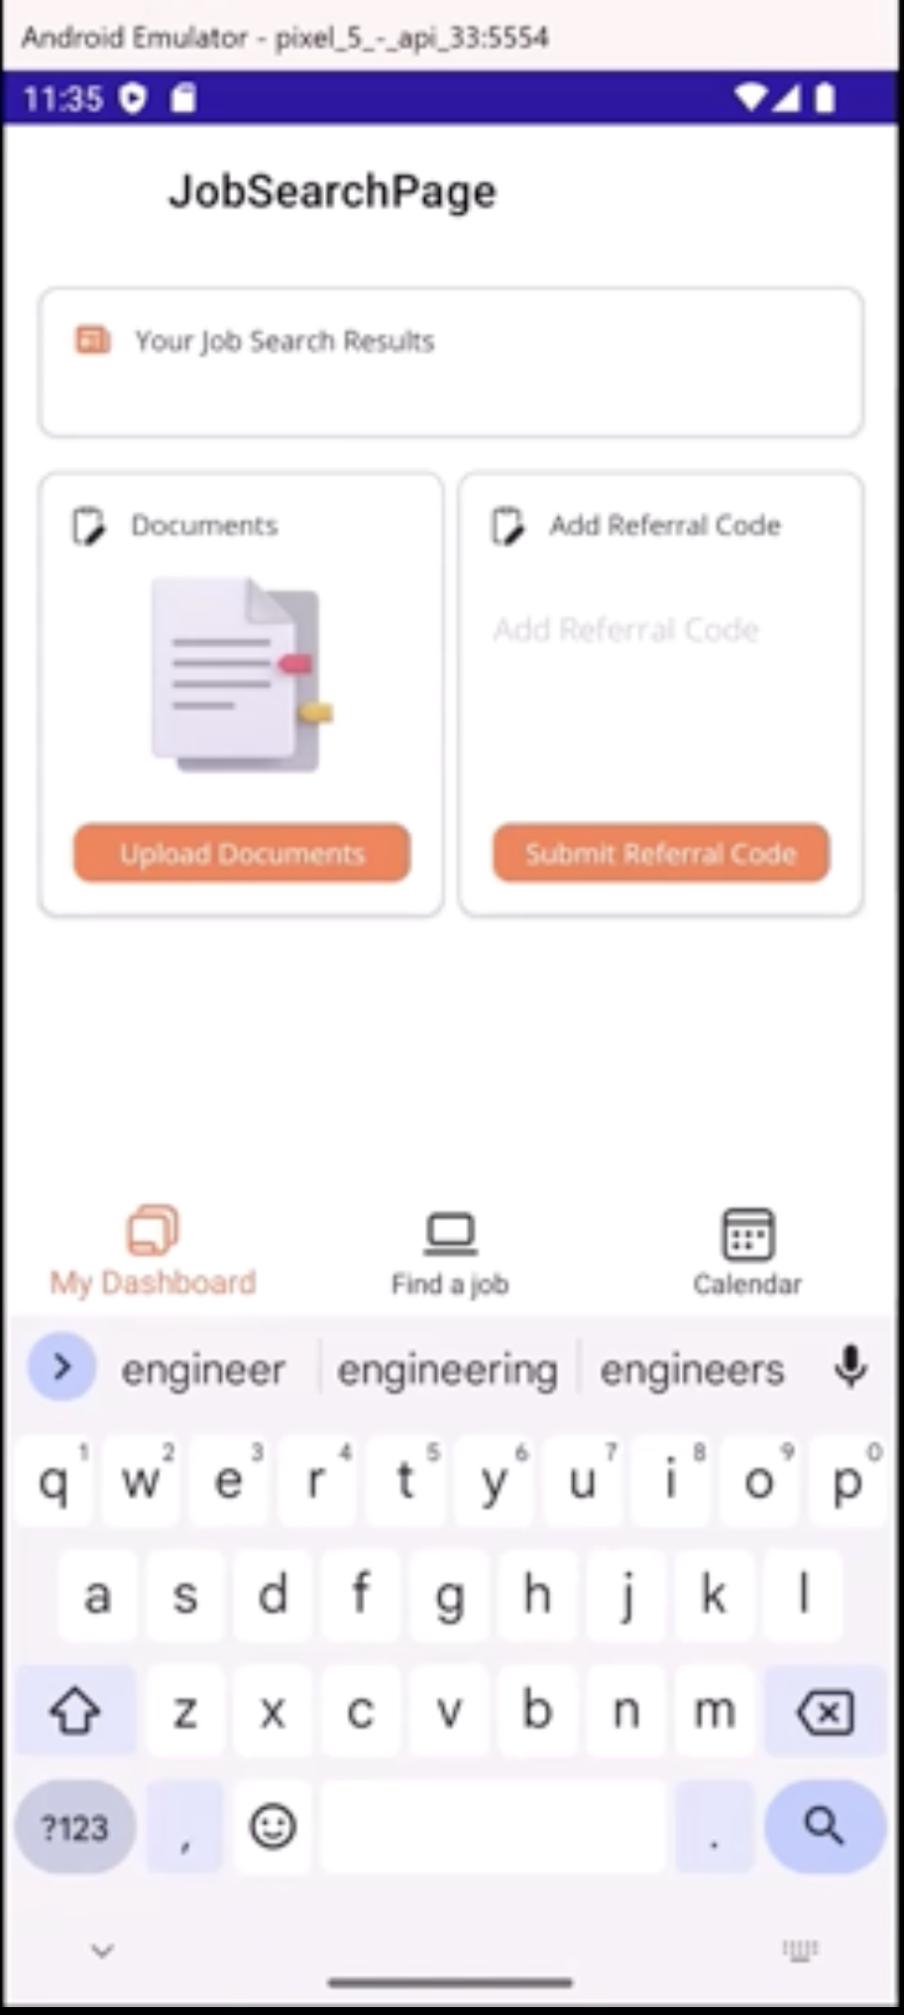
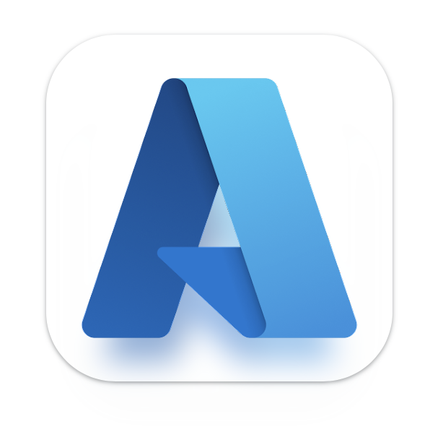
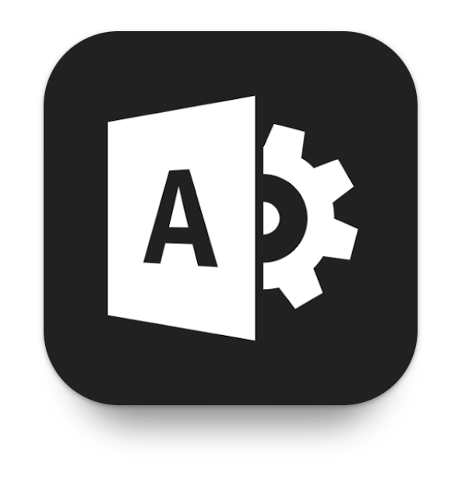

First Party Apps
Be My Guide
An application that connects people with partial or total loss of vision with nearby volunteers.
Hack the Hire
For recruiting and referrals of Black and Afro-Latinx talent for both students and professionals into Microsoft.

Slide 10
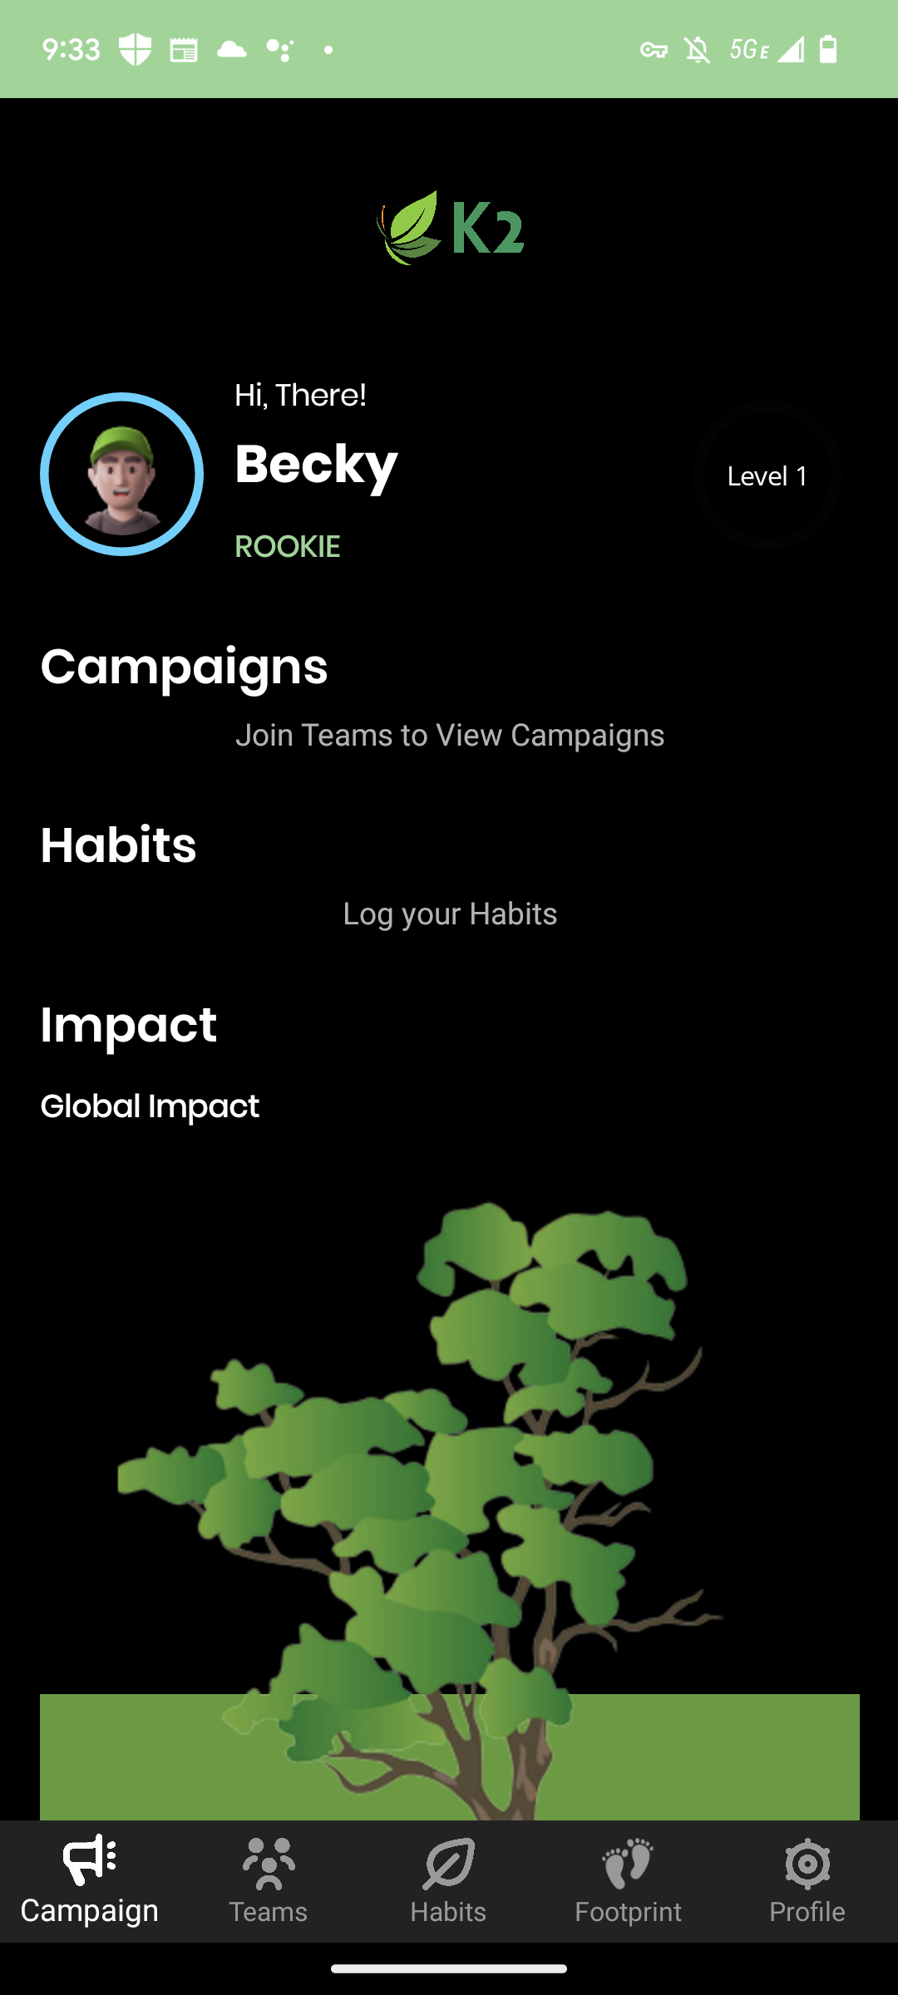
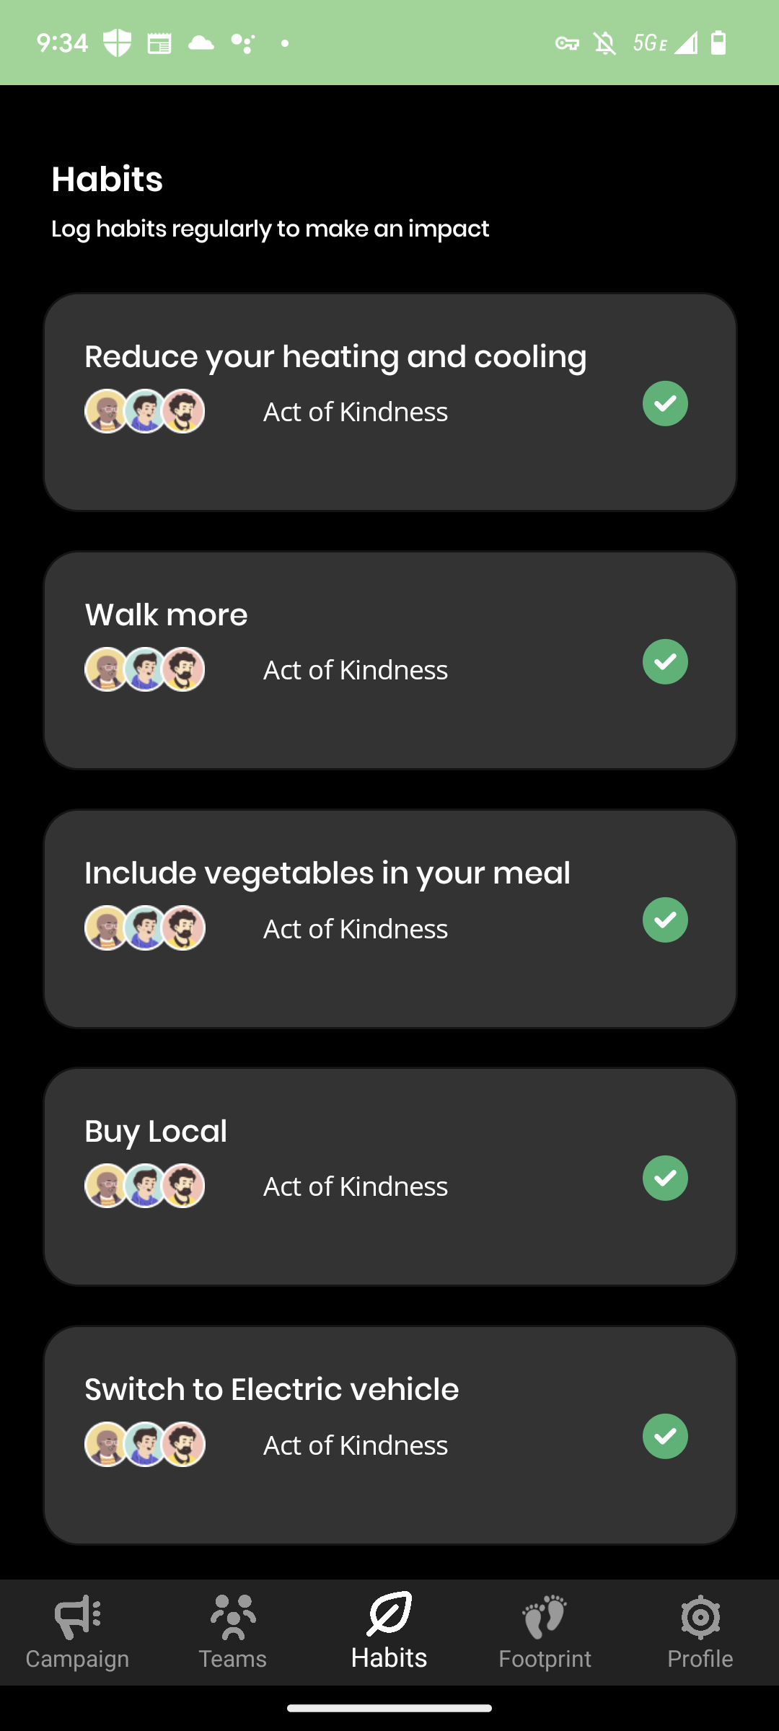
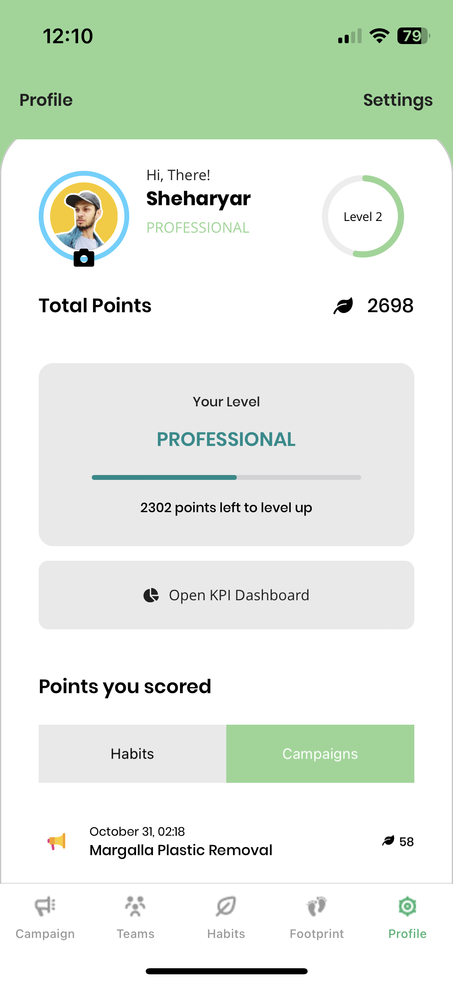
K2 | Klima Kampagne
K2 is developed to track climate contributions by individual and large teams/organizations. A campaign management tool to create teams, campaigns and custom habits. Earn points and calculate how much an individual emitted CO2 when taking flight from one city to another.

Slide 11


Logius
Your DigiD allows you to identify yourself when making arrangements on the internet, such as with the government, educational institutes, healthcare institutions or your pension fund.

Slide 12

“The inclusion in .NET MAUI of advancements in Windows app development towards WinUI3 and the Windows App SDK, combined with the new WebView2 control has allowed the combined web and native experience in some of our applications to have a truly consistent cross-platform experience.”
Civica

Slide 13
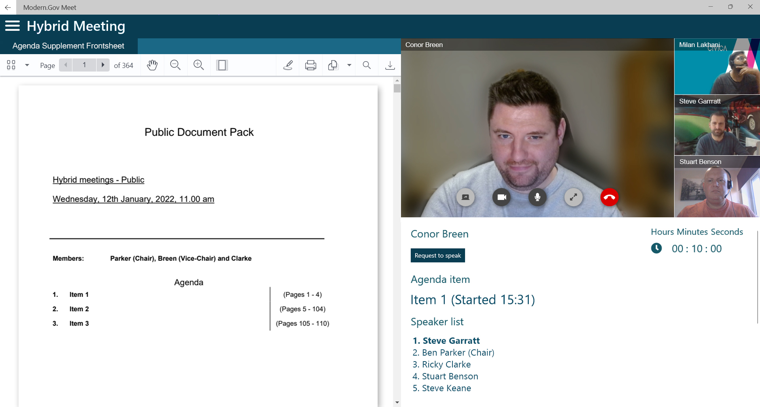
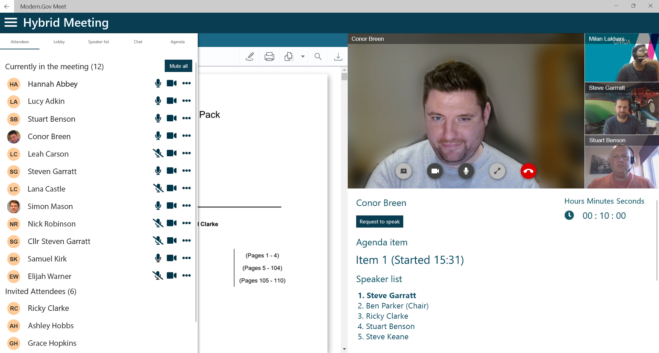
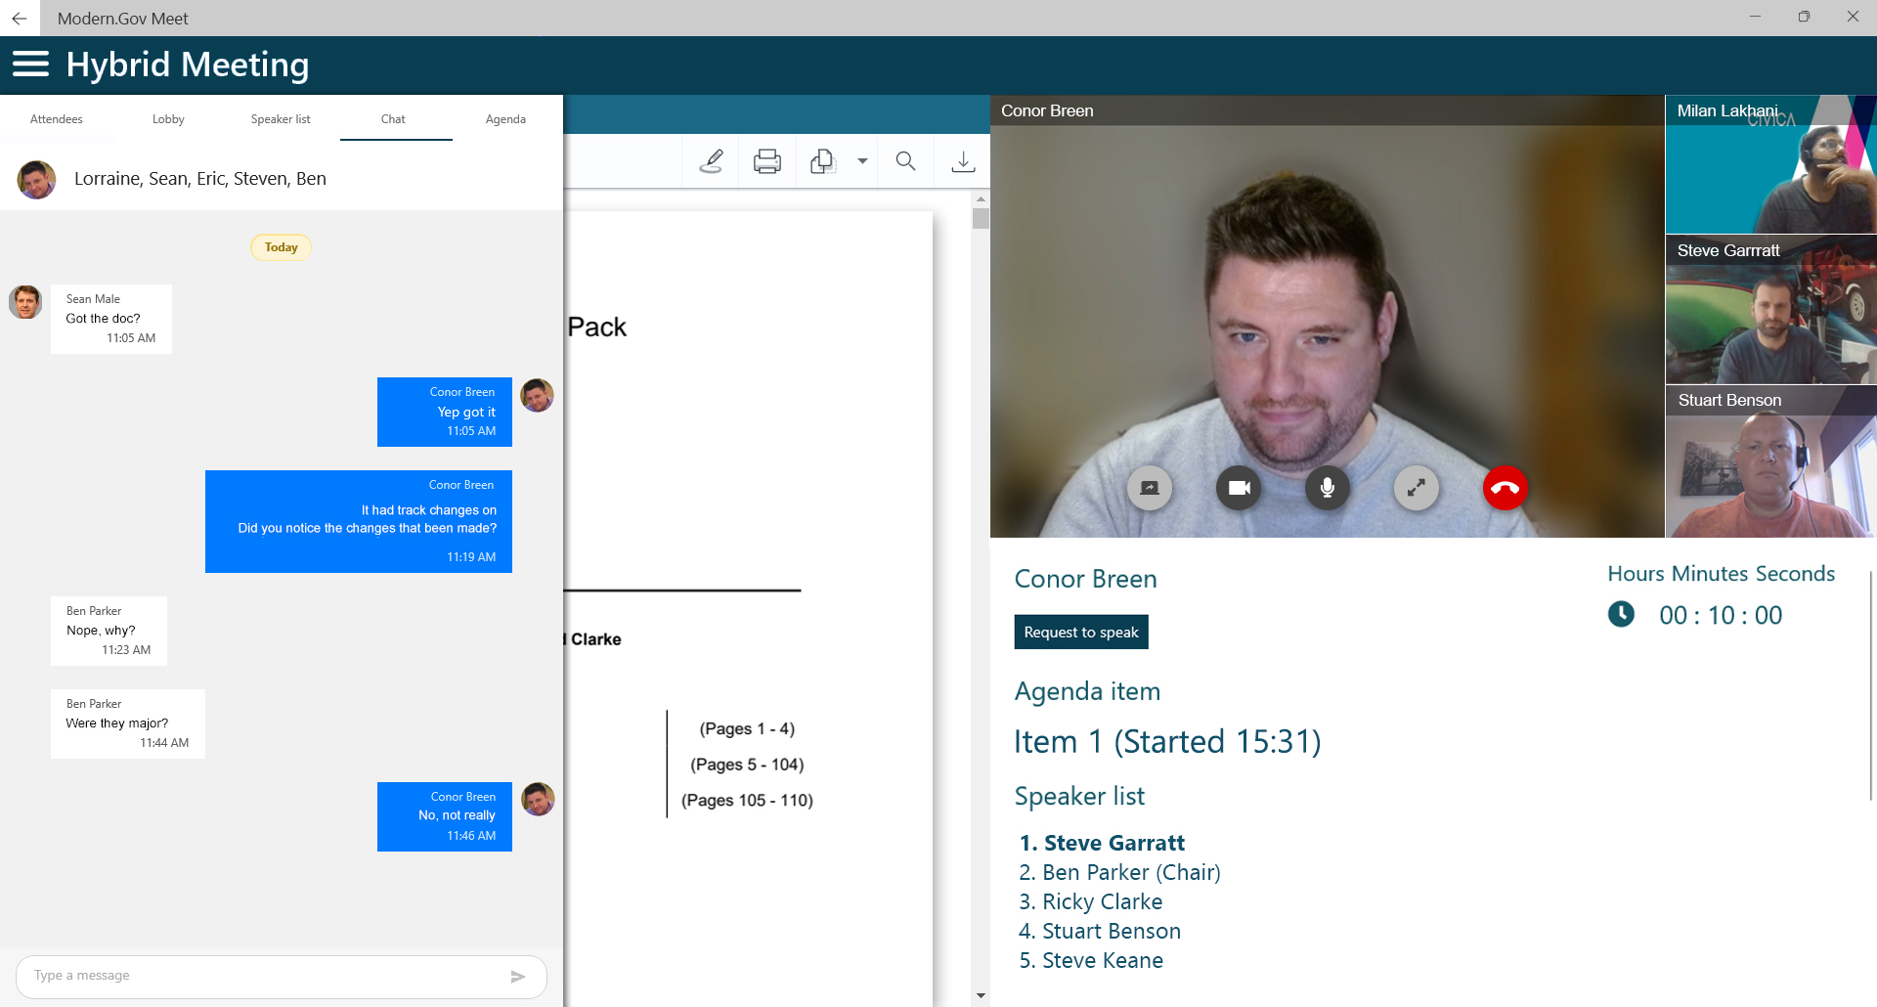
Modern.gov by Civica
A paperless meeting app for Councilors, Officers, and the Public.
Document management
Voting
Video conferencing, webcasting
Virtual meeting lobby
Call moderation

Slide 14
“The new handler architecture, combined with the simplified single-project structure, and improvements around compilation, startup and raw performance in .NET 6.0 (and again now with .NET 7.0) have helped not just to improve our apps startup time and performance, but greatly increase developer productivity with less time wasted.”
Civica

Slide 15
“The new handler architecture really opens up access to the native components with minimal overhead in terms of memory allocations and view hierarchy (compared with custom renderers). In our experience we've found that this even allows us to implement workarounds for issues in .NET MAUI itself whilst we await a fix, which is extremely powerful.”
Civica

Slide 16
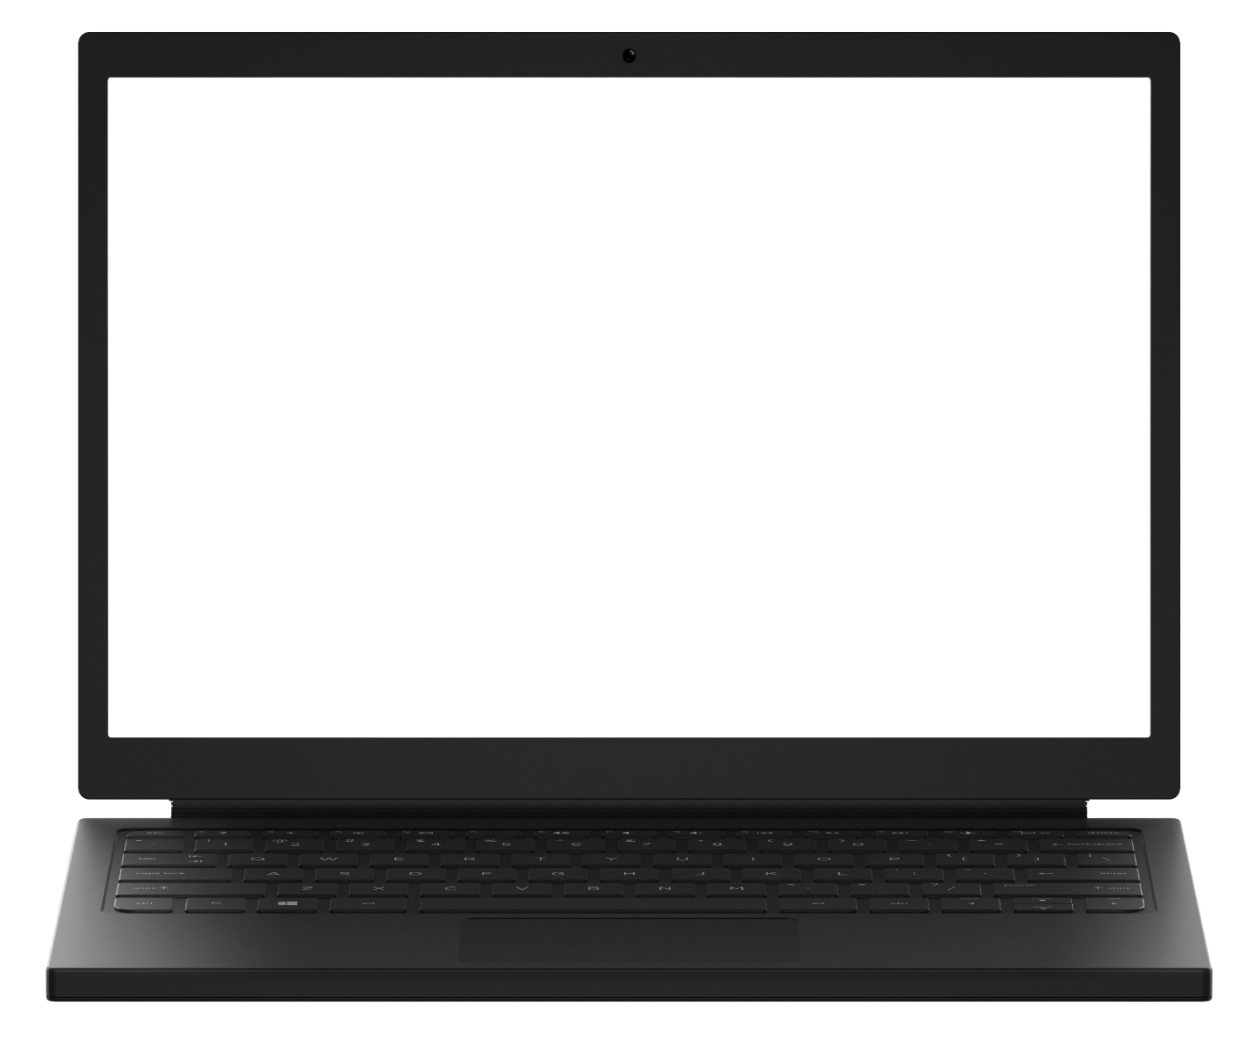
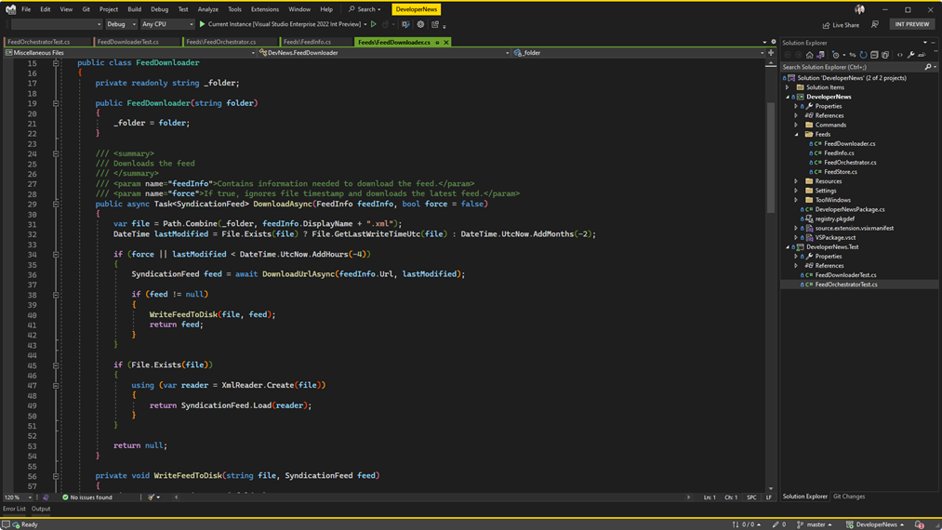

Visual Studio 2022 v17.4
RELEASED
Modern development for .NET 7 using WSL2
Code faster than ever before with Hot Reload
64-bit Performance, scale for any size project
visualstudio.com/download

Slide 17
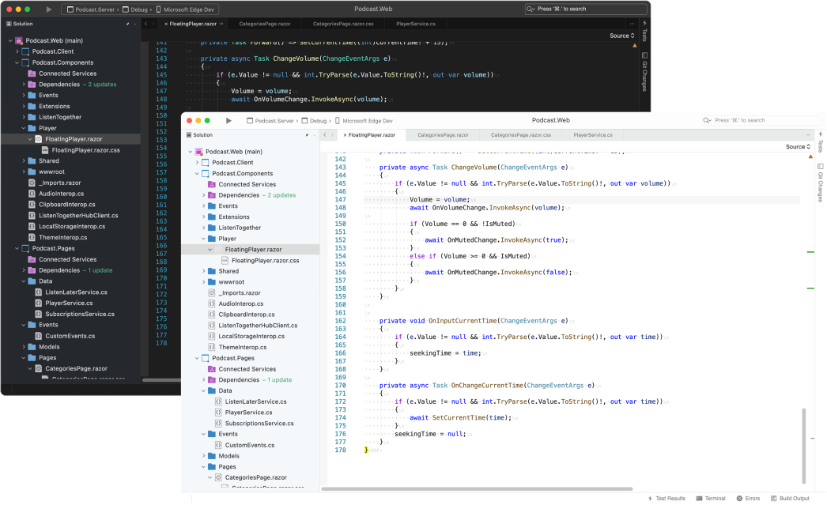

Visual Studio 2022 for Mac v17.4
RELEASED
Develop .NET 7 apps for web, mobile, desktop, and more
GA Support for developing .NET MAUI apps
Runs natively on M1 Macs
visualstudio.com/download

Slide 18
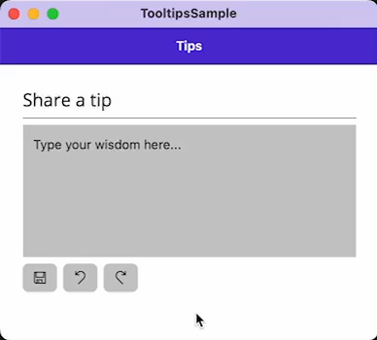
Tooltips
<HorizontalStackLayout Spacing="8">
<Button Text="{x:Static icons:FabIconFont.Save}"
ToolTipProperties.Text="Save"
FontFamily="FabricIcon"/>
<Button Text="{x:Static icons:FabIconFont.Undo}"
ToolTipProperties.Text="Undo"
FontFamily="FabricIcon"/>
<Button Text="{x:Static icons:FabIconFont.Redo}"
ToolTipProperties.Text="Redo"
FontFamily="FabricIcon"/>
</HorizontalStackLayout>

Slide 19
Pointer Hover
<Style TargetType="Button">
<Setter Property"FontSize" Value="18"/>
<Setter Property="VisualStateManager.VisualStateGroups">
<VisualStateGroupList>
<VisualStateGroup x:Name="CommonStates">
<VisualState x:Name="Normal">
<VisualState.Setters>
<Setter Property="Background" Value="{StaticResource Gray200}"/>
<Setter Property="TextColor" Value="{StaticResource Gray950}"/>
</VisualState.Setters>
</VisualState>
<VisualState x:Name="PointerOver">
<VisualState.Setters>
<Setter Property="TextColor" Value="{StaticResource White}" />
<Setter Property="Background" Value="{StaticResource Primary}" />
</VisualState.Setters>
</VisualState>
</VisualStateGroup>
</VisualStateGroupList>
</Setter>
</Style>

Slide 20
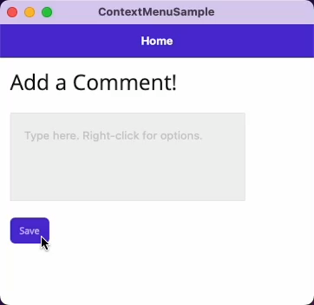
Context Menu
<Editor>
<FlyoutBase.ContextFlyout>
<MenuFlyout>
<MenuFlyoutItem Text="Increase font"
Clicked="OnIncrease"/>
<MenuFlyoutItem Text="Decrease font"
Clicked="OnDecrease"/>
<MenuFlyoutItem Text="Clear"
Clicked="OnClear"/>
</MenuFlyout>
</FlyoutBase.ContextFlyout>
</Editor>

Slide 21
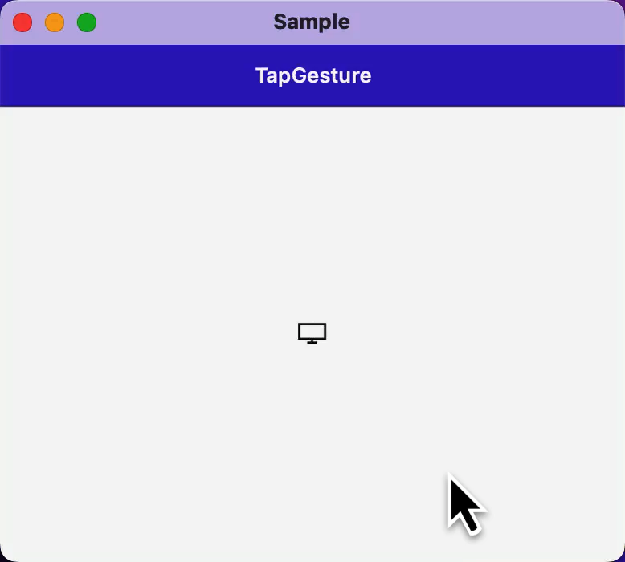
Right-Click
<Editor.GestureRecognizers>
<TapGestureRecognizer Buttons="Primary"
NumberOfTapsRequired="2"
Tapped="Primary_Tapped"/>
<TapGestureRecognizer Buttons="Secondary"
Tapped="Secondary_Tapped"/>
</Editor.GestureRecognizers>

Slide 22
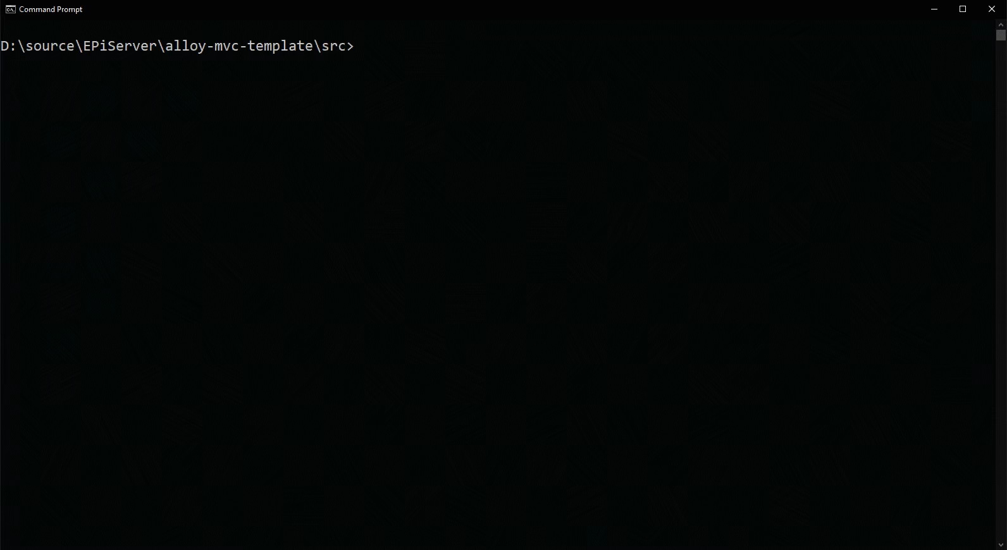
Modernizing to .NET MAUI from Xamarin.Forms
Not a complete rewrite of your application – just an upgrade
Join Sweeky Satpathy tomorrow at 17:00 PST for all the details! ⬆️
Upgrade Assistant support in development – try it today and send us your feedback

Slide 23
Release schedule, support & patching
Patches for 18 months (6 months after .NET 8 ships)
.NET MAUI
.NET 7
Nov 2022
.NET 8
Nov 2023
.NET 9
Nov 2024
14
Xcode
32, 33
Android
Xamarin
EOS May 2024
A major version of .NET MAUI will ship with .NET going forward (.NET 7, .NET 8, etc.)
.NET MAUI is an optional workload with external dependencies (such as Xcode & Android SDK tools)
A major version of .NET MAUI will receive patches for 6 months after a successor (major version) ships
Xamarin SDKs will receive support until May 2024
Notes:
.NET MAUI is governed by the Microsoft Modern Lifecycle. Here’s how it works….
CLICK
A major version of .NET MAUI will ship with .NET going forward (.NET 7, .NET 8, etc.)
CLICK
.NET MAUI is an optional workload with external dependencies such as Xcode & Android SDK tools
CLICK
Because of this, a major version of .NET MAUI will receive support and patches for 6 months after a successor ships
CLICK
Xamarin will reach end of support in May 2024, at which point we will stop patching.
The takeaway is you are always supported on the latest mobile and desktop technologies. You will find that this is the best support in the industry today.

Slide 24
Learn More: Day 1
13:30 - 14:00 PST | What's new in .NET MAUI and Desktop Apps | Shane Neuville
14:00 - 14:30 PST | Performance Improvements in .NET MAUI (.NET 7 edition) | Jonathan Peppers
14:30 - 15:00 PST | Create native desktop & mobile apps using web skills in Blazor Hybrid | Eilon Lipton, James Montemagno
18:30 - 19:00 PST | Build amazing cross-platform UI for .NET with Avalonia UI! | Mike James
20:00 - 20:30 PST | Extending apps to mobile and desktop with .NET MAUI and Oqtane | Shaun Walker

Slide 25
Learn More: Day 2 & 3
Day 2 | Wednesday, November 9
17:00 - 17:30 PST | Upgrading Xamarin apps to .NET MAUI | Sweekriti Satpathy
Day 3 | Thursday, November 10
00:00 - 00:30 PST | Tips and tricks on platform-code implementation in .NET MAUI | Luis Beltran
00:30 - 01:00 PST | Aloha .NET MAUI Community Toolkit | Gerald Versluis
14:00 - 14:30 PST | Building Accessible Apps with .NET MAUI | Rachel Kang (SHE/HER)

Slide 26
Thank You!
Let's build amazing apps with .NET 7 get.dot.net/7
Notes:
Let me close this morning by thanking each and every one of you that has been on this journey with us or are just starting your development journey with .NET.
.NET 7 is available today for developers alongside Visual Studio 2022 and Visual Studio for Mac 2022 version 17.4 so you can start building amazing apps today.
Thank you so much and have a great .NET Conf!

